Slide 1
MBBA / IBBA PARTNERSHIP
NEW MEMBER BENEFIT

Slide 2
Why add IBBA to MBBA membership?
Positive investment into future growth of organization
Enhancing value proposition to current and future members as well as our clients
Cost savings and added benefits to all business broker members.
Will attract new broker members currently not MBBA members

Slide 3
Benefits Overview
Business Reference Guide Online (Retail Value: $170)
BizMiner Industry Reports (Retail Value: $1,095)
ValueSource Market Comps Database (Retail Value: $575)
V-Rooms Virtual Data Room License with Unlimited Rooms (Retail Value: $2,000)
Preferred Pricing on all IBBA online and live education and Conferences
Monthly Webinar Series with access to archive of past webinars
Support Programs & Peer Sharing
Broker Profile on IBBA.org
Program to achieve certification (CBI designation)
https://www.ibba.org/membership/membership-benefits

Slide 4
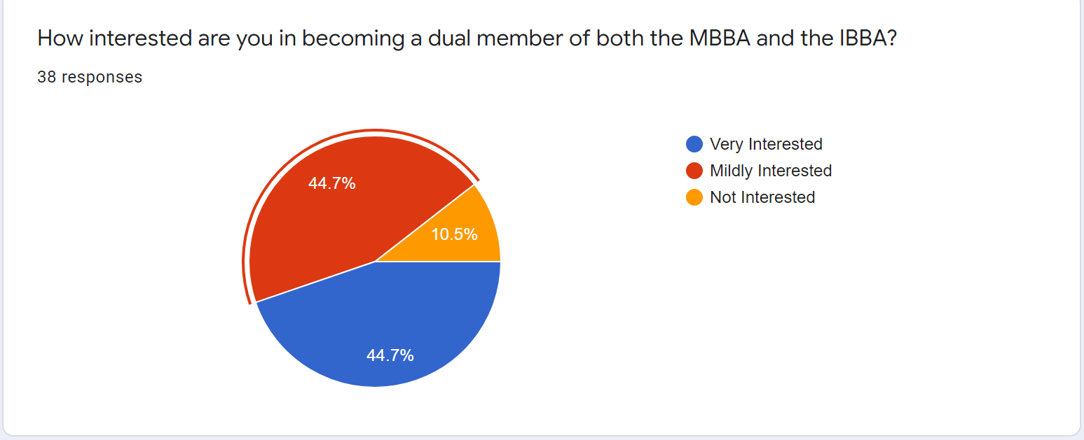
MBBA MEMBERS SURVEY RESULTS

Slide 5
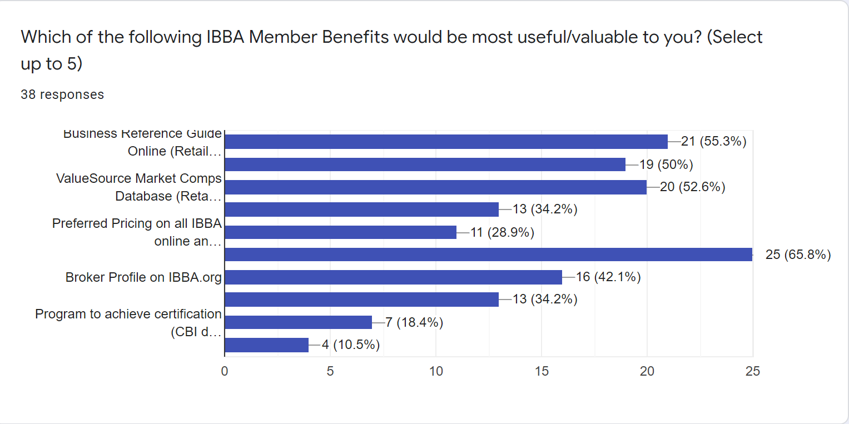

Slide 6
PARTNER AGREEMENT DETAILS
The agreement is between MBBA and IBBA (not members individually)
2-year commitment agreement with IBBA
Minimum 50 members bulk purchase
Billed in January for current roster and quarterly going forward
The IBBA benefit offered to ALL business brokers (no opt-outs)

Slide 7
Changes to current MBBA structure
Renewal invoices to go out by October 31st due by December 31st
Two tier membership structure:
- full membership (broker membership)
- associate membership (professional advisors)
Due increase starting 2021 renewals
Voted and approved by State Board on 09/29/20

Slide 8
Cost of the IBBA Membership Benefit
2021
Total annual cost: $125 x 50 = $6,250
$3,125 per Chapter
2022
Total annual cost: $150 x 50 = $7,500
$3,750 per Chapter
***actual number depends on exact member count billed per Chapter

Slide 9
MBBA Membership Pricing comparison
Without IBBA/MBBA Partnership
With IBBA/MBBA Partnership
IBBA Individual Membership $475
MBBA Individual Membership $150
TOTAL Investment: $625
MBBA Individual Membership $250
TOTAL Investment: $250
IBBA Individual Membership $0
Savings $375 to member

Slide 10
DUES INCREASE
DUES INCREASE IS NOT AIMED AT FUNDING THIS PROGRAM
DUES have not been increased in 30 years
NESSECARY in order to sustain current level of membership support and continue to enhance benefits
DUES are reviewed annually, and we don’t foresee any further increased in the next couple of years
FULL MEMBERSHIP (Business Broker) - $250
ASSOCIATE MEMBERSHIP (Professional Advisors)- $200
Application Fee for new members - $50

Slide 11
FAQS: DUAL MBBA/IBBA MEMBERSHIP PROGRAM
If I am a non-broker member of the MBBA and want the benefits of IBBA membership, is there a way I can become a dual member?
Yes. The IBBA does not restrict membership to brokers only. However, they do not offer different membership types for non-brokers or benefits tailored to non-brokers.
Most non-broker MBBA members will likely not derive enough value/benefits from dual membership to justify the cost to the MBBA. However, non-broker members will enjoy enhanced networking opportunities and potential business from a growing number of broker members who will be attracted by the value of the dual MBBA/IBBA membership.

Slide 12
FAQS: DUAL MBBA/IBBA MEMBERSHIP PROGRAM
If I am already an IBBA member who has recently paid IBBA dues, will my membership dues be prorated?
Yes.
How will this work?
The IBBA will work directly with each current IBBA member to calculate a fair proration, and all existing IBBA members will move to a calendar year dual IBBA/MBBA membership going forward.

Slide 13
FAQS: DUAL MBBA/IBBA MEMBERSHIP PROGRAM
If I hold the CBI designation, how and when will my designation recertification fee be paid?
The CBI designation recertification fee will continue to be invoiced separately by the IBBA directly to the CBI designee.

Slide 14
FAQS: DUAL MBBA/IBBA MEMBERSHIP PROGRAM
What is the process to offer Dual MBBA/IBBA Membership beginning on January 1, 2021?
The following steps need to occur to begin offering Dual Memberships in January 2021:
Each Chapter Board will vote to recommend that the State Board consider and vote on adopting Dual IBBA/MBBA Memberships.
The MBBA will sign a non-disclosure agreement with the IBBA to allow the sharing of data including membership data.
The IBBA will conduct a “list analysis” to ensure offering dual memberships makes economic sense for the IBBA. Because so few MBBA members are already IBBA members, it is fully anticipated that this analysis will support the economic rationale needed for the IBBA to participate.
The MBBA and IBBA will enter into a written agreement to offer dual memberships.
The MBBA will provide the IBBA with a final list of broker members who will become dual members in 2021 under the program.
IBBA will provide IBBA Benefits webinars to educate our members on the many benefits of dual membership.

Slide 15
FAQS: DUAL MBBA/IBBA MEMBERSHIP PROGRAM
What do our Members have to do to activate their Dual Membership?
Because of data privacy issues, every MBBA/IBBA dual member will have to proactively activate their member benefits online with the IBBA. An email with a link to do this will be sent to each qualifying MBBA member.
How and when will new MBBA members who join after January 1st become dual IBBA/MBBA members?
New brokers joining the MBBA will automatically become dual MBBA/IBBA members. Once a quarter, the IBBA will send the MBBA an invoice for any new members who joined in the previous quarter.

Slide 16
NEXT STEPS
Chapter Board approval: by September 20th
State Board approval: by September 30th
NDA signed with IBBA: by October 15th
IBBA agreement signed: by October 30th
Planning meetings with IBBA: Nov/Dec
Roll out the benefit: by January 1, 2021

